Slide 1

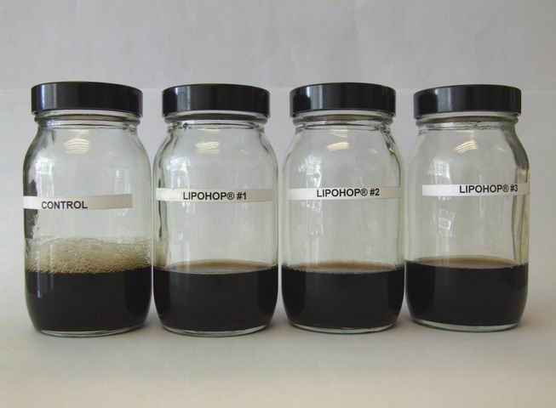
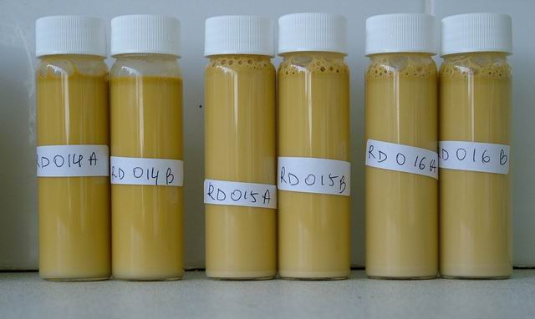
44
MASTER BREWERS ASSOCIATION OF THE AMERICAS
MBAA Annual Conference
October 13 – 15, 2011
Hilton Minneapolis
Minneapolis, MN
ANTIFOAMS FROM HOPS
Y-Y Ford¹, KT Westwood¹, A Gahr², A Rajca-Ferreira³, K Wolinska¹, M Lad⁴
1 – Barth Innovations Ltd, Paddock Wood, UK; 2 - Hopfenveredlung St. Johann GmbH & Co. KG, Train-St Johann, Germany; 3 – Botanix Ltd, Paddock Wood, UK; 4 – University of Nottingham, UK
ABSTRACT
Control of foaming is important during brewing operations, especially at the fermentation stage. We have developed hop-based solutions for this problem (Fig. 1). These are emulsions of hop extracts in water that show effective antifoam action together with potentially beneficial effects on the final beer.
Pilot brewery trials were conducted, using the hop extract emulsions as antifoam agents during fermentation, to assess both the antifoam performance and the effects on the final beer. A dose rate of 10 – 50 g/hl (100 – 500 ppm) of the emulsions successfully suppressed foaming to the same extent as commercial silicone antifoam used at 5 ml/hl. Use of the hop extract emulsions increased utilization of the hop bitter acids so that the final beers had elevated levels of bitterness compared to the control (no antifoam). In addition, the hop extract emulsions also had a positive effect on the final beer foam stability. The positive effects on hop acid utilization and on beer foam stability are thought to be due to decreases in losses of iso-alpha-acids. Iso-alpha-acids will partition into the foam phase and thus partial loss of these components is likely to be due to foam deposition on vessel walls etc.
The positive results from the brewing trials have encouraged us to further develop the formulation to enhance effectiveness. A simple, rapid and reproducible method has been devised to test antifoam performance in the laboratory, and results are presented to show that this method is a reliable predictor of antifoam performance in a pilot brewery trial.
Since the products are based on hop extract and natural emulsifiers, the stability, both in terms of performance and microbiological contamination, is important. Data from storage trials conducted under ambient conditions, and under accelerated ageing at 30 - 40 ºC, show that the emulsions remain microbiologically clean, and effective as antifoams, for at least 12 months.
KEY OBJECTIVES
The key objectives of this applied research and development project are summarised here. An existing antifoam emulsion had been developed previously based on hop fats and waxes (UK patent GB 2,444,359 B; worldwide patents pending), and we experimented with the formulation to improve performance while keeping within the commercially important parameters below:
Effective antifoam performance – the emulsion needed to provide antifoam activity comparable to the well-known silicone antifoams
Easy to handle and dose
Natural emulsifying agents to complement the hop-based nature of the antifoam base
Microbiologically stable
No carry-over of antifoam effect or taste and aroma into the final beer
FORMULATION
Sunflower lecithin is ideal as a natural emulsifying agent to complement the hop fats and waxes. The hop fats and waxes can be emulsified directly into water (see the left pair of emulsions in Fig. 1), but the antifoam performance is relatively poor. Addition of lecithin improves the antifoam performance in a dose-dependent fashion, as shown in Fig. 4 on the left. Lecithin on its own does not show good antifoam performance, hence the synergy between the lecithin emulsifier and the hop fats and waxes is important.
Fig. 4.
Fig. 7.
PILOT PLANT BREWERY TRIALS
(Lipohop C and Lipohop C-Plus refer to formulations with different ratios of hop fats and waxes to sunflower lecithin)
RAPID ASSESSMENT OF ANTIFOAM PERFORMANCE
We required a rapid but reliable method to assess antifoam performance of the antifoam emulsions. Since the antifoam emulsions were designed to be dosed into the fermentation vessel, we wanted a simple test that would predict how effectively the emulsion might reduce foaming levels during the fermentation of wort. Antifoam emulsion was dosed at 100 - 500 ppm into beer and shaken for 5 minutes on a laboratory oscillator. The height of the foam was measured immediately after shaking, and after a further 3 minutes of standing. The photograph above left (Fig. 2) shows the results from one test – the 3 experimental samples containing the antifoam show clear foam control compared to the control.
The bar chart on the left (Fig. 3) shows a comparison of results obtained from the simple “beer shake” test described above, and from a pilot plant brew where the emulsions were used as antifoams in the fermentation vessel. It can be seen that there is a good correspondence between the results. This provides confidence that the simple, 8-minute laboratory test is a good predictor of antifoam performance in brewing operations.
Fig. 8.
STABILITY
Emulsions were tested for antifoam performance after 10 months storage under ambient conditions. Fig. 8 on the left shows that antifoam performance was not impaired by storage. Storage samples were also tested for microbiological contamination after 3, 6, 9 and 12 months storage under ambient conditions, and no contamination was detected (data not shown).
Fig. 2.
Fig. 5.
Fig. 3.
Fig. 6.
CONCLUSIONS
By adjusting the relative proportions of hop fats and waxes, and sunflower lecithin as a natural emulsifier, an effective antifoam emulsion can be prepared that shows good stability and does not carry over into the final beer when dosed into the fermenter. Beer brewed using the antifoam emulsions showed better final foam stability and increased utilisation of hop bitterness – this is probably due to lower losses of iso-alpha-acids in the foam phase during fermentation.
Fig. 1. Antifoam emulsions prepared from hop fats and waxes.
Left pair: hop fats and waxes emulsified directly into water. Centre pair: with 1% lecithin as emulsifier. Right pair: with 2% lecithin as emulsifier.

